Slide 1
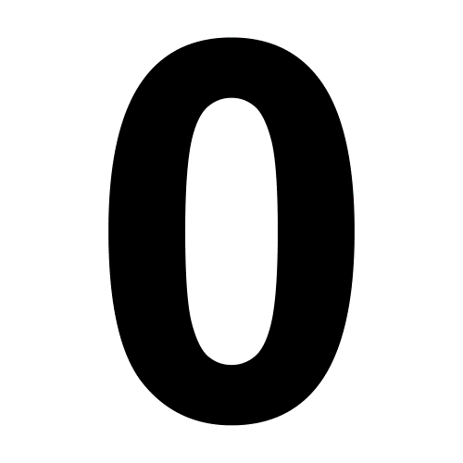
21
ZERO
FIVE

Slide 2
20
TWO
ONE

Slide 3
19
TWO
FOUR

Slide 4
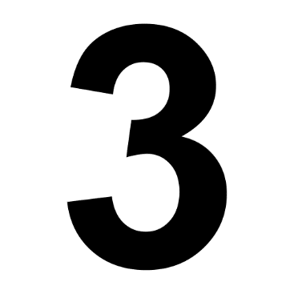
18
THIRTEEN
THREE

Slide 5
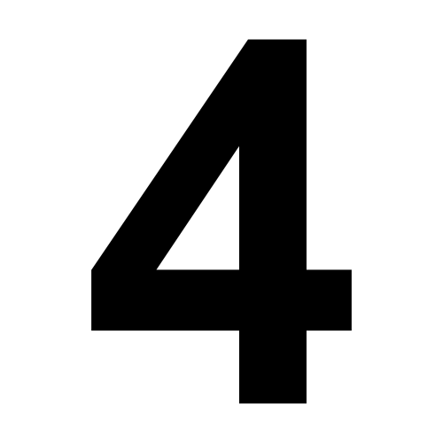
17
FOUR
TEN

Slide 6
16
NINE
FIVE

Slide 7
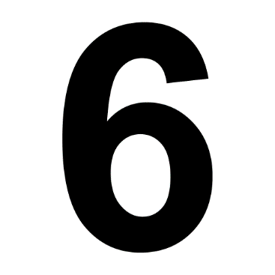
15
SIX
SEVEN

Slide 8
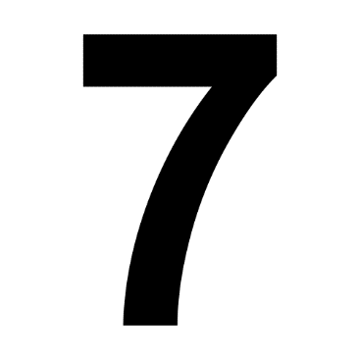
14
TWO
SEVEN

Slide 9
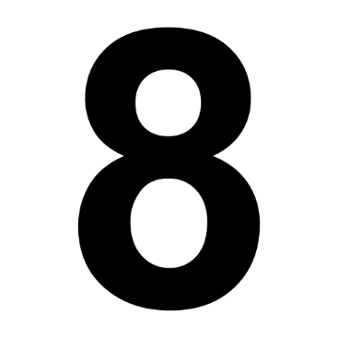
13
EIGHT
ONE

Slide 10
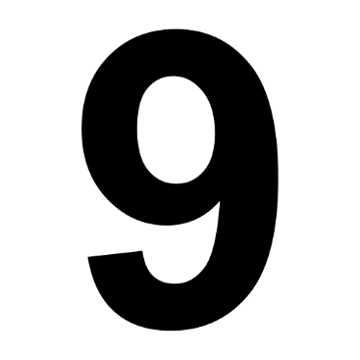
12
THREE
NINE

Slide 11
11
TEN
FOUR

Slide 12
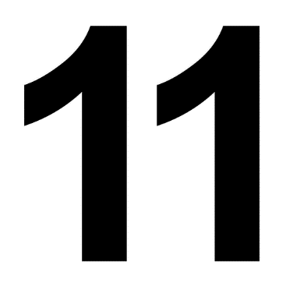
10
EIGHT
ELEVEN

Slide 13
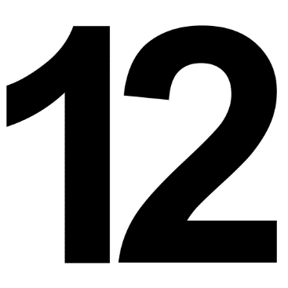
09
TWO
TWELVE

Slide 14
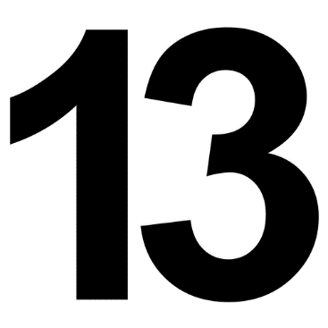
08
THIRTEEN
THREE

Slide 15
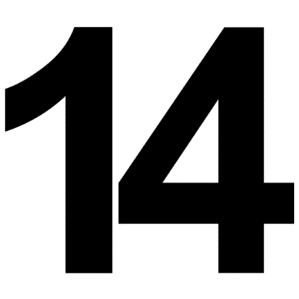
07
FOURTEEN
FOUR

Slide 16
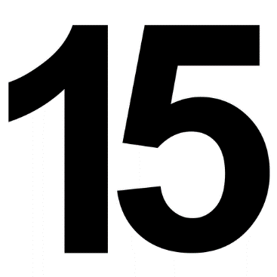
06
FIVE
FIFTEEN

Slide 17
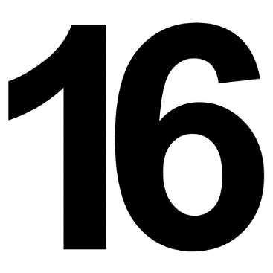
05
SIXTEEN
SIX

Slide 18
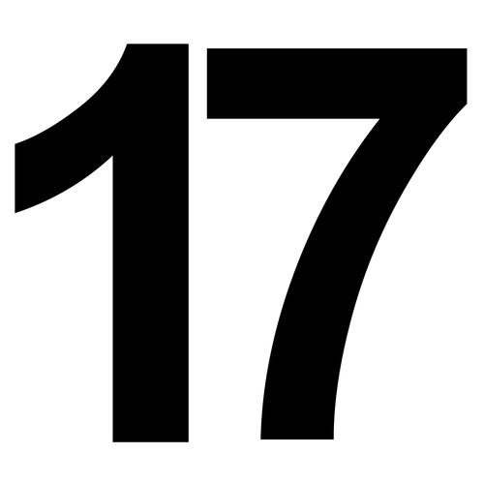
04
SEVENTEEN
SEVEN

Slide 19
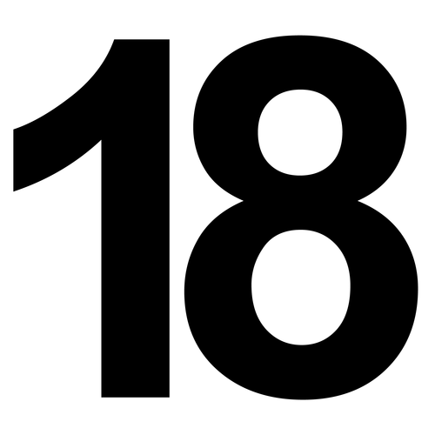
03
EIGHTEEN
EIGHT

Slide 20
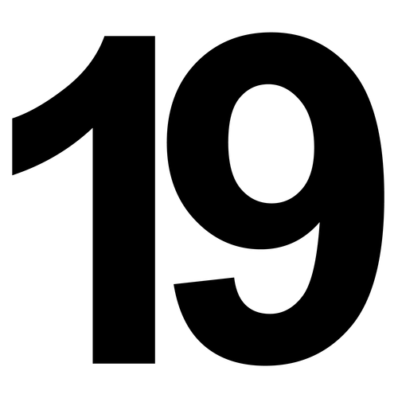
02
NINE
NINETEEN

Slide 21
01
TWO
TWENTY

