Slide 1
08
PENCIL
PEN

Slide 2
07
BOOK
RUBBER

Slide 3
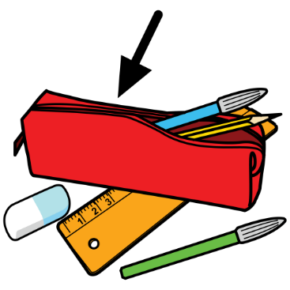
06
SHARPENER
PENCIL CASE

Slide 4
05
RULER
PENCIL

Slide 5
04
RUBBER
BOOK

Slide 6
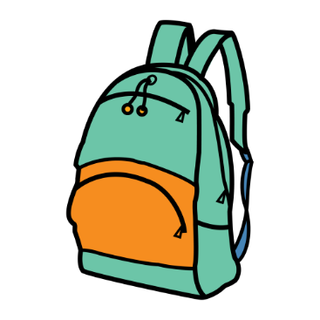
03
SCHOOL BAG
PENCIL CASE

Slide 7
02
PENCIL
SHARPENER

Slide 8
01
RULER
RUBBER

