Slide 1
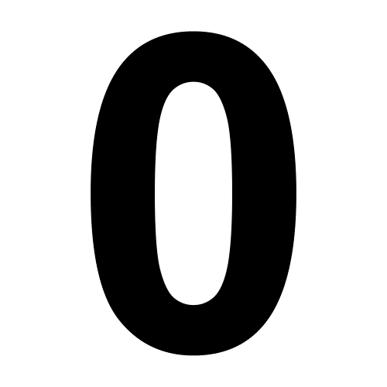
ZERO
FIVE

Slide 2
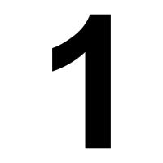
TWO
ONE

Slide 3
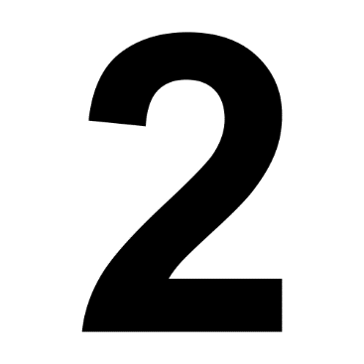
TWO
FOUR

Slide 4
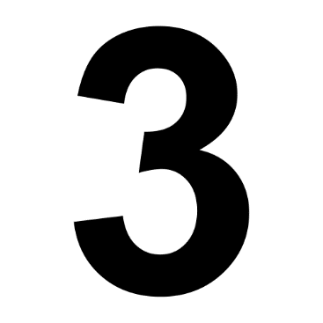
THIRTEEN
THREE

Slide 5
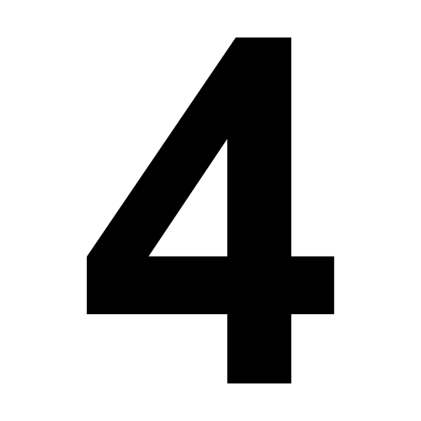
FOUR
TEN

Slide 6
NINE
FIVE

Slide 7
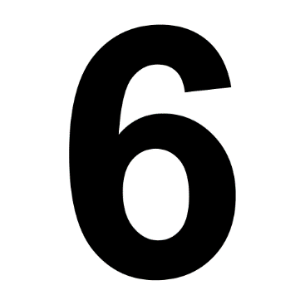
SIX
SEVEN

Slide 8
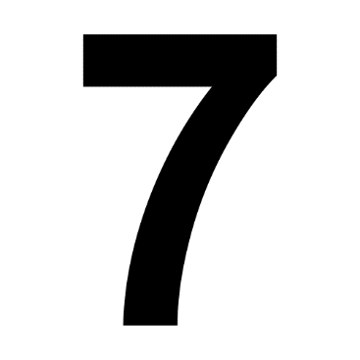
TWO
SEVEN

Slide 9
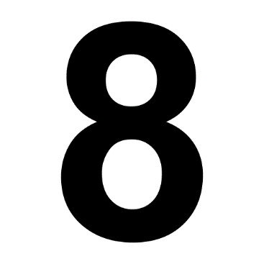
EIGHT
ONE

Slide 10
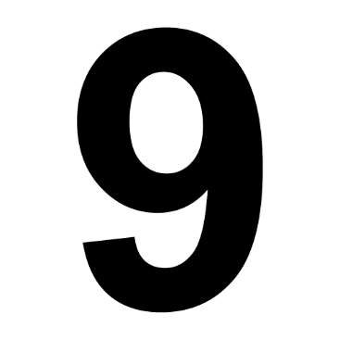
THREE
NINE

Slide 11
TEN
FOUR

Slide 12
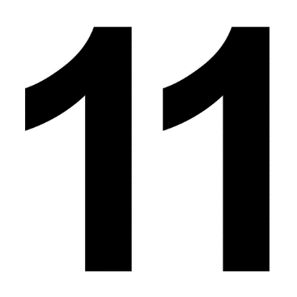
EIGHT
ELEVEN

Slide 13
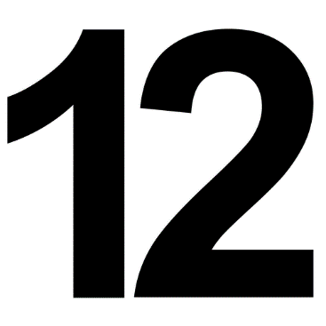
TWO
TWELVE

Slide 14
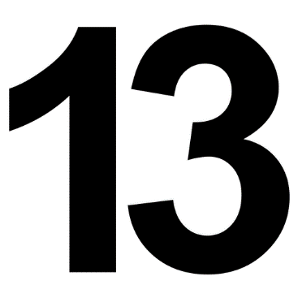
THIRTEEN
THREE

Slide 15
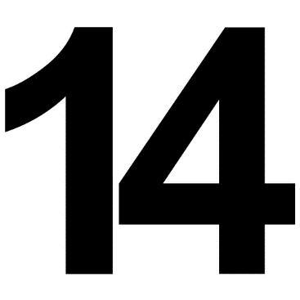
FOURTEEN
FOUR

Slide 16
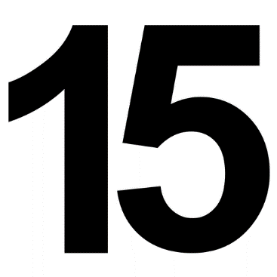
FIVE
FIFTEEN

Slide 17
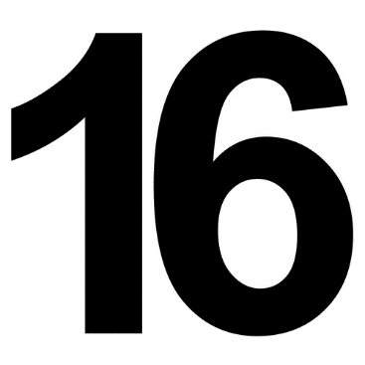
SIXTEEN
SIX

Slide 18
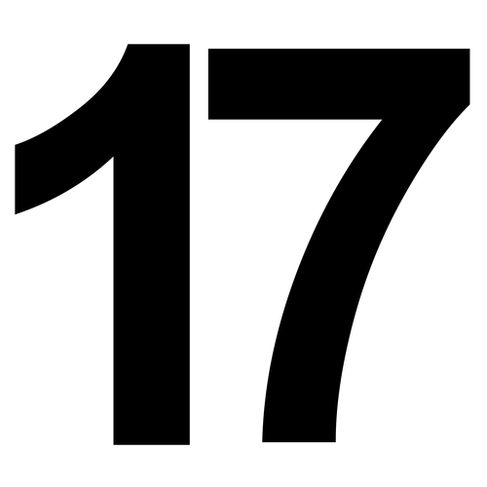
SEVENTEEN
SEVEN

Slide 19
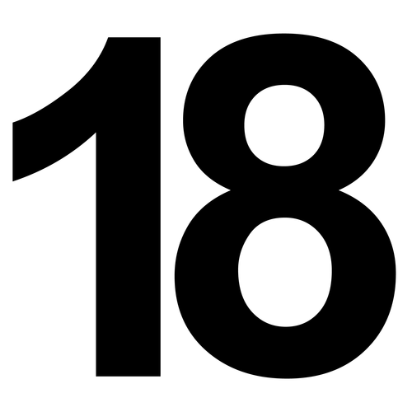
EIGHTEEN
EIGHT

Slide 20
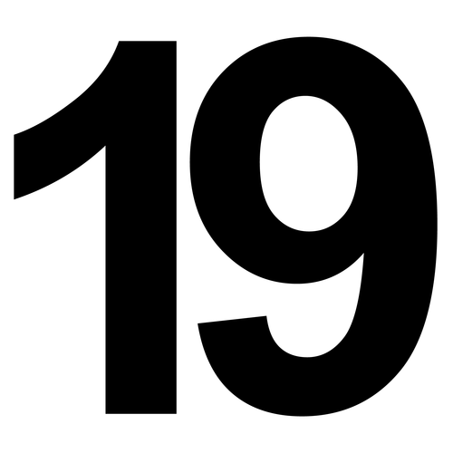
NINE
NINETEEN

Slide 21
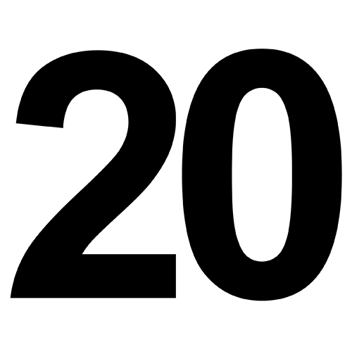
TWO
TWENTY

