Slide 1
INGLÉS
ESCOLA II.
SCHOOL
Autor pictogrames: Sergio Palao Procedència: ARASAAC (http://arasaac.org) Llicència: CC (BY-NC-SA) Propietat: Govern de Aragó Editat: FUNDACIÓN ADIMIR

Slide 2
TEACHER

Slide 3
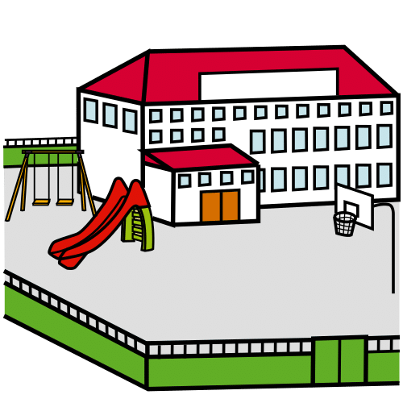
SCHOOL

Slide 4
PENCIL CASE

Slide 5
BAG

Slide 6
CRAYONS

Slide 7
SHARPENER

Slide 8
ACTIVITY

Slide 9
TEACHER
CRAYONS

Slide 10
SCHOOL
BAG

Slide 11
SHARPENER
PENCIL CASE

Slide 12
BAG
SCHOOL

Slide 13
PENCIL CASE
CRAYONS

Slide 14
TEACHER
SHARPENER

Slide 15
CRAYONS
TEACHER

Slide 16
BAG
SCHOOL

Slide 17
PENCIL CASE
SHARPENER

Slide 18
BAG
SCHOOL

Slide 19
CRAYONS
PENCIL CASE

Slide 20
TEACHER
SHARPENER

